Slide 1
HEART DISEASES PREDICTION
TSP- AI ML Fundamentals (Capstone Project)
Presented By:
MOHAMMED ASLAM S
au422621105306
UNIVERSITY COLLEGE OF ENGINEERING PANRUTI
Guided By:
Dr. RAMAR BOSE

Slide 2
OUTLINE
Problem Statement (Should not include solution)
Proposed System/Solution
Algorithm & Deployment
GitHub Link
Project Demo(photos / videos)
Conclusion
Future Scope
References

Slide 3
Problem Statement
Predicting heart diseases involves using computer programs to analyze medical information and make predictions about who might develop heart problems in the future. This process includes collecting data like age, blood pressure, cholesterol levels, and lifestyle habits, then using that data to train a computer model. Once trained, this model can look at new data from someone and give an indication of whether they're at risk for heart disease. It's like having a digital assistant that helps doctors identify potential issues early on, so they can take action to keep people healthy.

Slide 4
Proposed Solution
Collect Data: Get information from people, like their age, blood pressure, and lifestyle habits.
Prepare Data: Make sure the data is clean and organized so the computer can understand it.
Find Patterns: Teach the computer to look for patterns in the data that might indicate someone could develop a heart problem.
Train the Computer: Show the computer lots of examples of people with and without heart diseases so it can learn what to look for.
Test the Computer: Give the computer new examples it hasn't seen before to see if it can predict who might have heart issues.
Adjust and Improve: Keep refining the program based on how well it predicts and make it better over time.
Use the Program: Once it's good at predicting, use the program to help doctors identify people who might need extra care to keep their hearts healthy.

Slide 5
Algorithm & Deployment
Pick an Algorithm: Choose a simple algorithm like Decision Trees.
Get Data: Gather information about patients like age, blood pressure, and cholesterol levels.
Clean Data: Make sure the data is neat and ready for analysis, handling any missing or weird values.
Divide Data: Split the data into two parts: one for teaching the algorithm and one for testing how well it works.
Teach the Algorithm: Use the training data to teach the algorithm to recognize patterns that suggest heart disease.
Check Performance: Test the algorithm on the other part of the data to see how accurately it predicts heart disease.
Improve if Needed: Adjust the algorithm if it's not doing well, maybe by tweaking settings or trying a different approach.
Make it Work: Once it's doing a good job, put the algorithm into a system that doctors can use to help identify patients at risk for heart disease.
Keep an Eye on it: Keep checking how well the algorithm is working and update it as needed to keep it accurate and helpful.

Slide 6
GitHub Link
https://github.com/mohammedaslam007/heart-disease-prediction

Slide 7
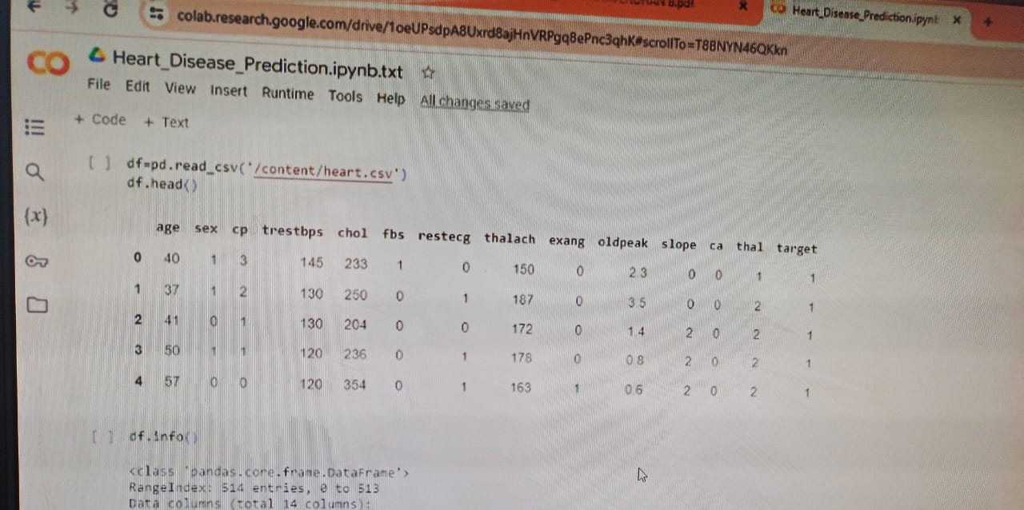
Project Demo(Recorded Video)
https://github.com/mohammedaslam007/heart-disease-prediction/blob/aedaa04dcfc907b5255d74fcaa45f56848ade877/PROJECT%20DEMO.mp4

Slide 8
Conclusion
In conclusion, predicting heart diseases is vital for early detection and intervention, ultimately improving patient outcomes and saving lives. By developing a simple algorithm using techniques like Decision Trees and following a straightforward development process, we can create a valuable tool for healthcare professionals. This tool can assist in identifying individuals at risk of heart diseases based on their medical data, helping doctors make informed decisions and provide timely treatments. With continuous monitoring and updates, we can ensure the algorithm remains accurate and effective in real-world scenarios, contributing to better healthcare delivery and patient well-being.

Slide 9
Future Scope
Better Algorithms: We can try using smarter computer programs to make more accurate predictions. These programs could learn from more data and make better guesses about who might get heart problems.
New Information: We can look for more types of information that might help predict heart diseases, like genetic data or lifestyle habits.
Personalized Predictions: Instead of one-size-fits-all predictions, we can make predictions tailored to each person's unique characteristics, like age, gender, and health history.
Real-time Monitoring: Imagine if we could use devices like smartwatches to monitor people's heart health in real-time, giving early warnings of potential issues.
Making it Clear: We should aim to make these predictions easy for doctors to understand and use, so they can make informed decisions about their patients' health

Slide 10
References
1. Project Github link , Ramar Bose , 2024
2. Project video recorded link (youtube / github), Ramar Bose , 2024
3. Project PPT & Report , Ramar Bose , 2024

Slide 11
THANK YOU

